Slide 1
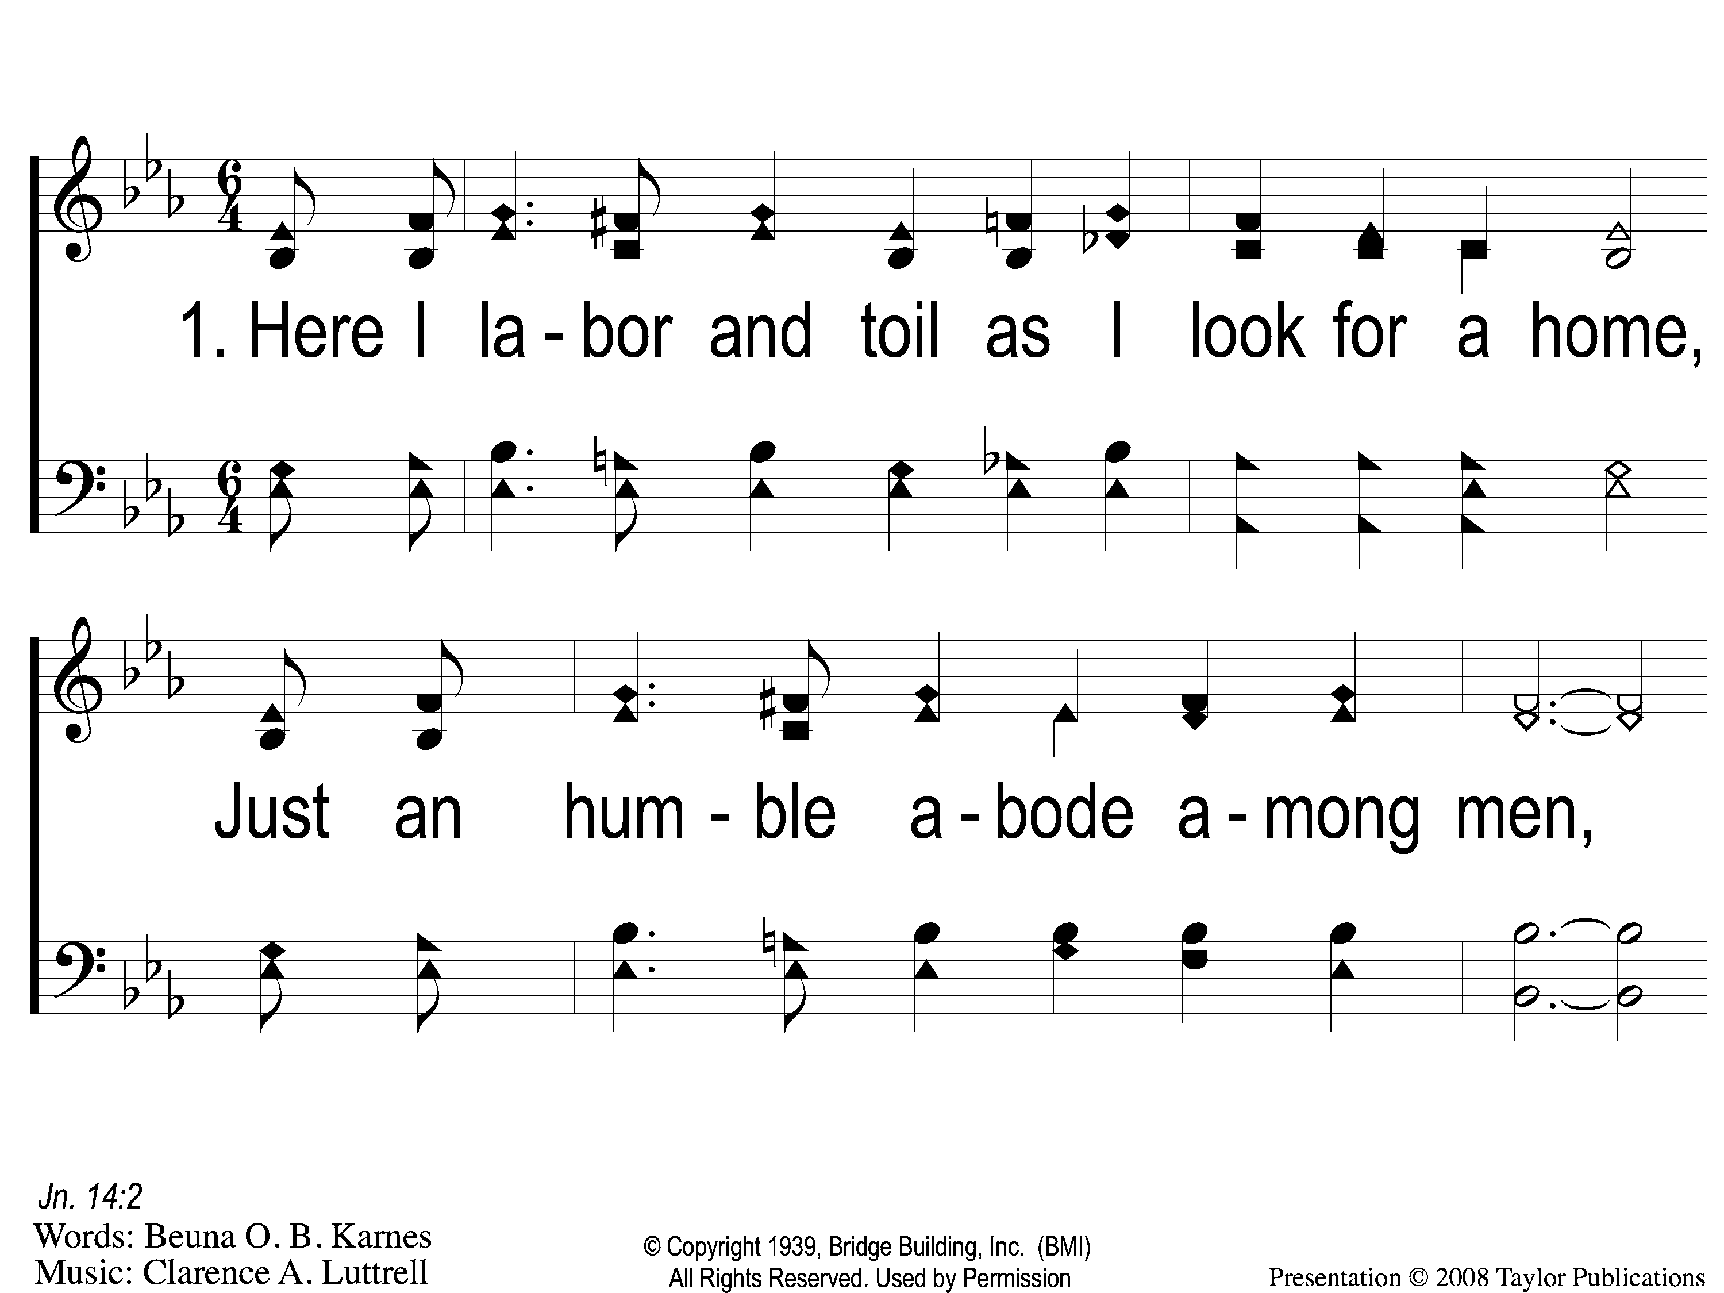
1-1 An Empty Mansion
An Empty Mansion
5

Slide 2
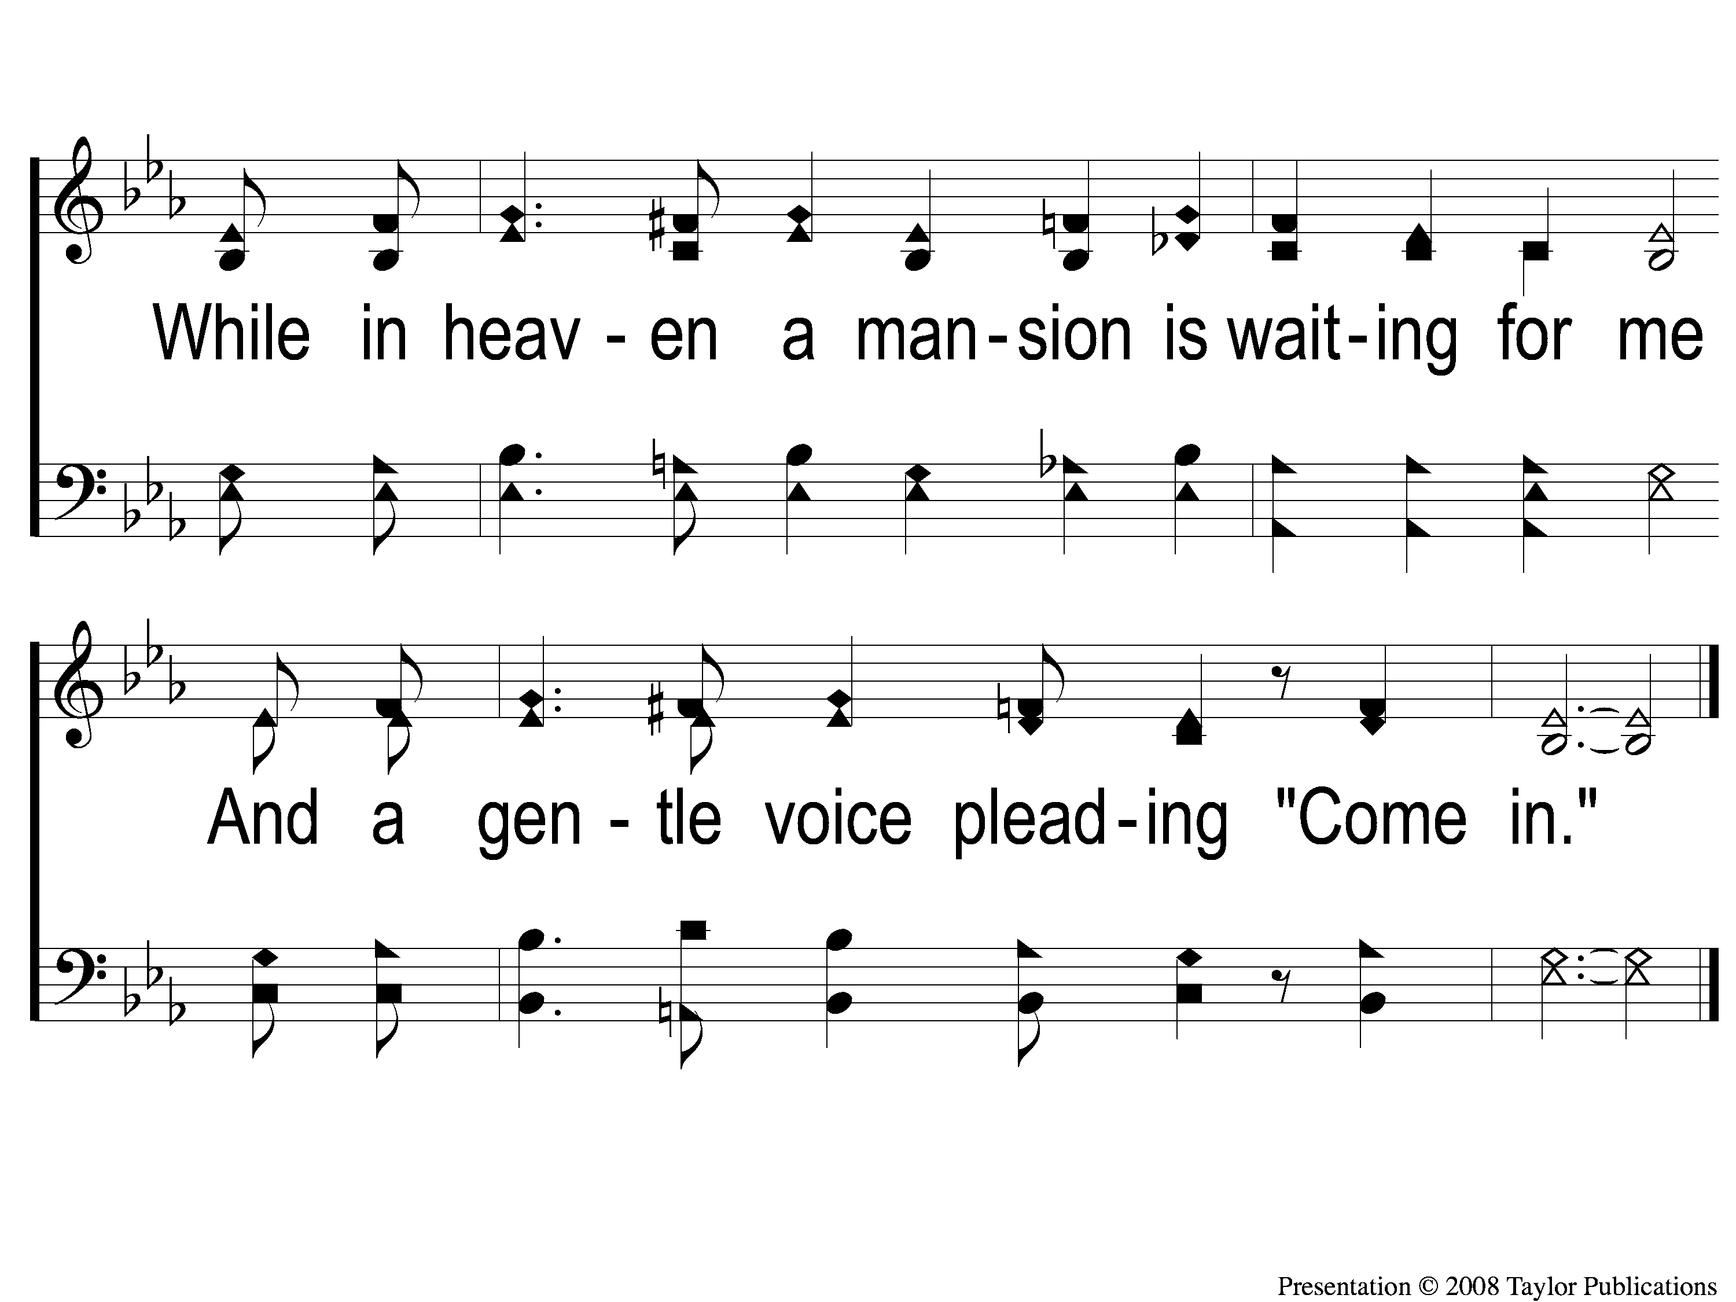
1-2 An Empty Mansion
An Empty Mansion
5

Slide 3
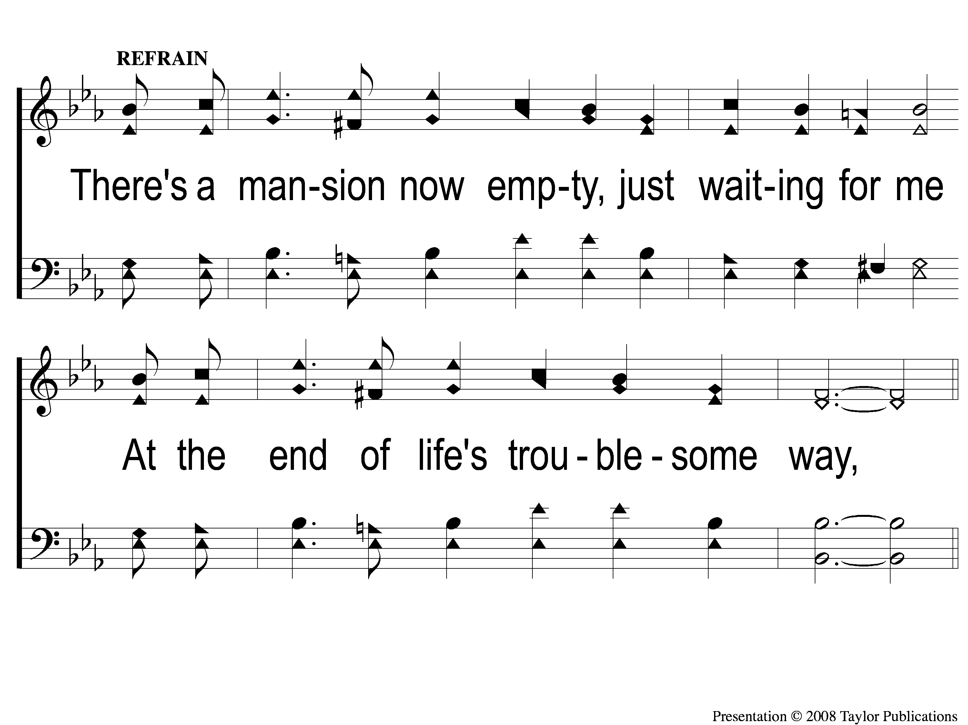
C-1 An Empty Mansion
An Empty Mansion
5

Slide 4
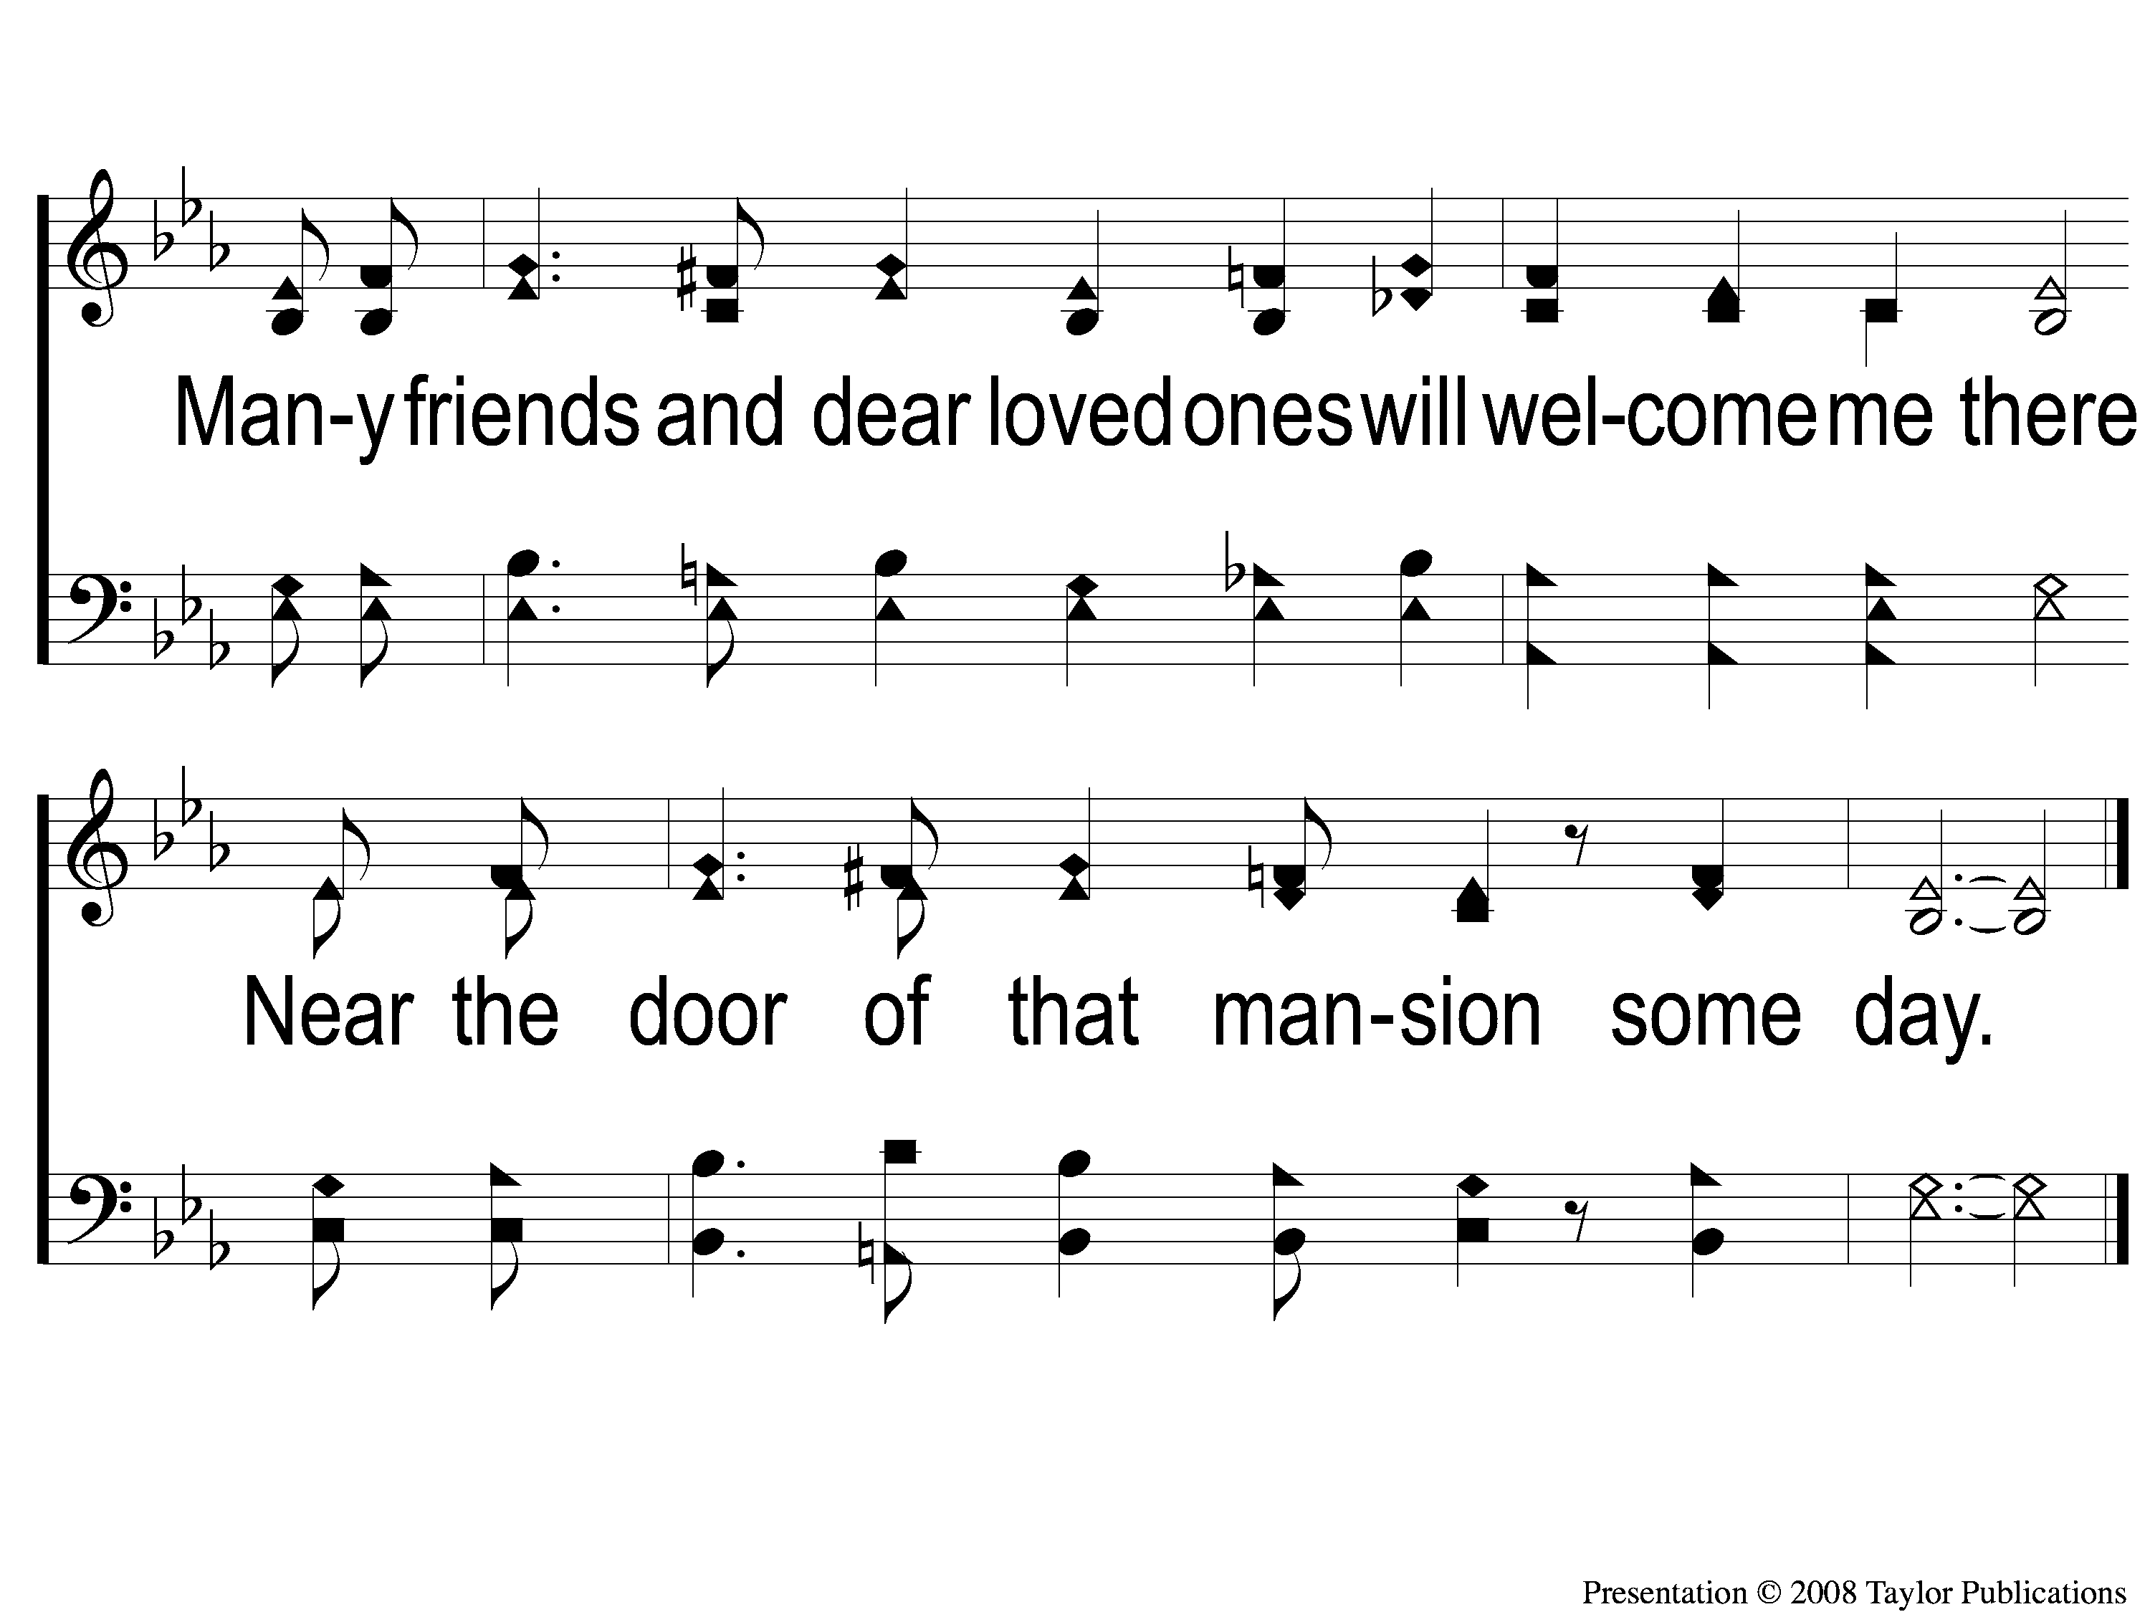
C-2 An Empty Mansion
An Empty Mansion
5

Slide 5
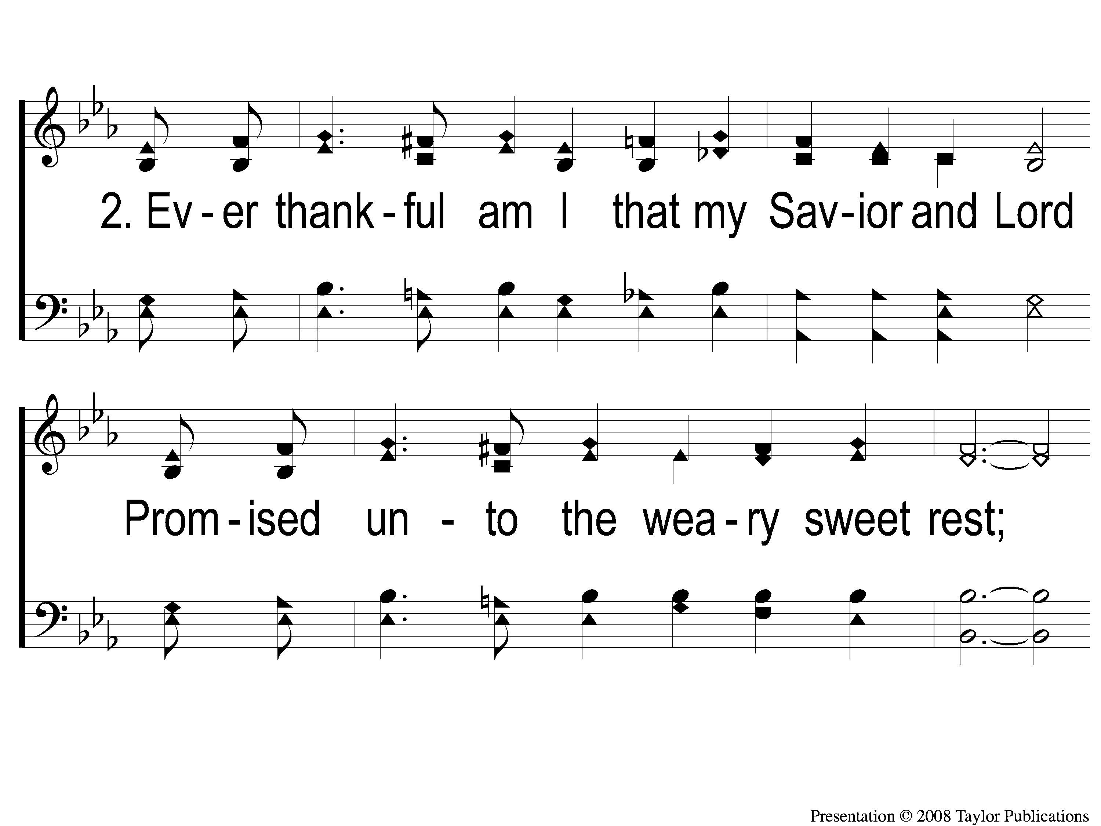
2-1 An Empty Mansion
An Empty Mansion
5

Slide 6
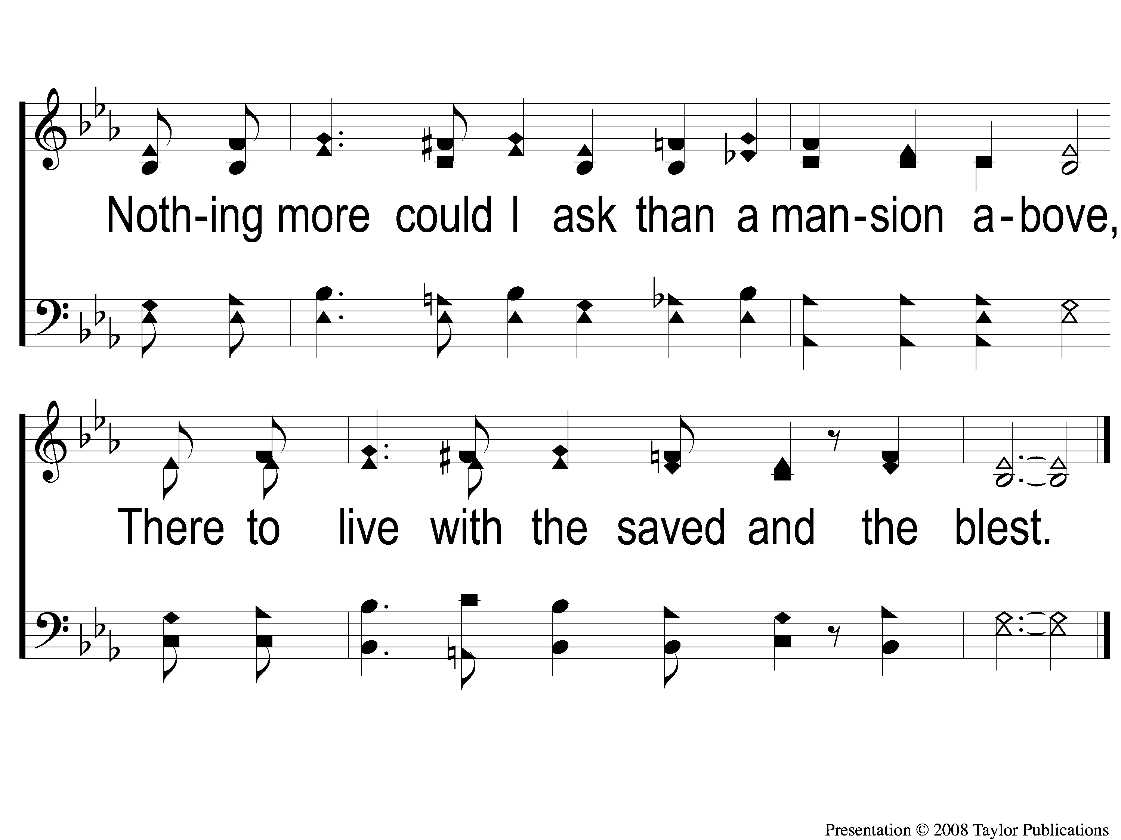
2-2 An Empty Mansion
An Empty Mansion
5

Slide 7
C-1 An Empty Mansion
An Empty Mansion
5

Slide 8
C-2 An Empty Mansion
An Empty Mansion
5

Slide 9
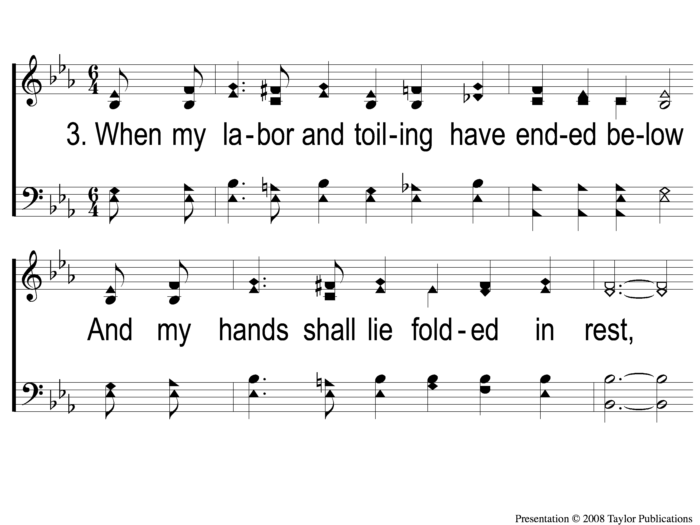
3-1 An Empty Mansion
An Empty Mansion
5

Slide 10
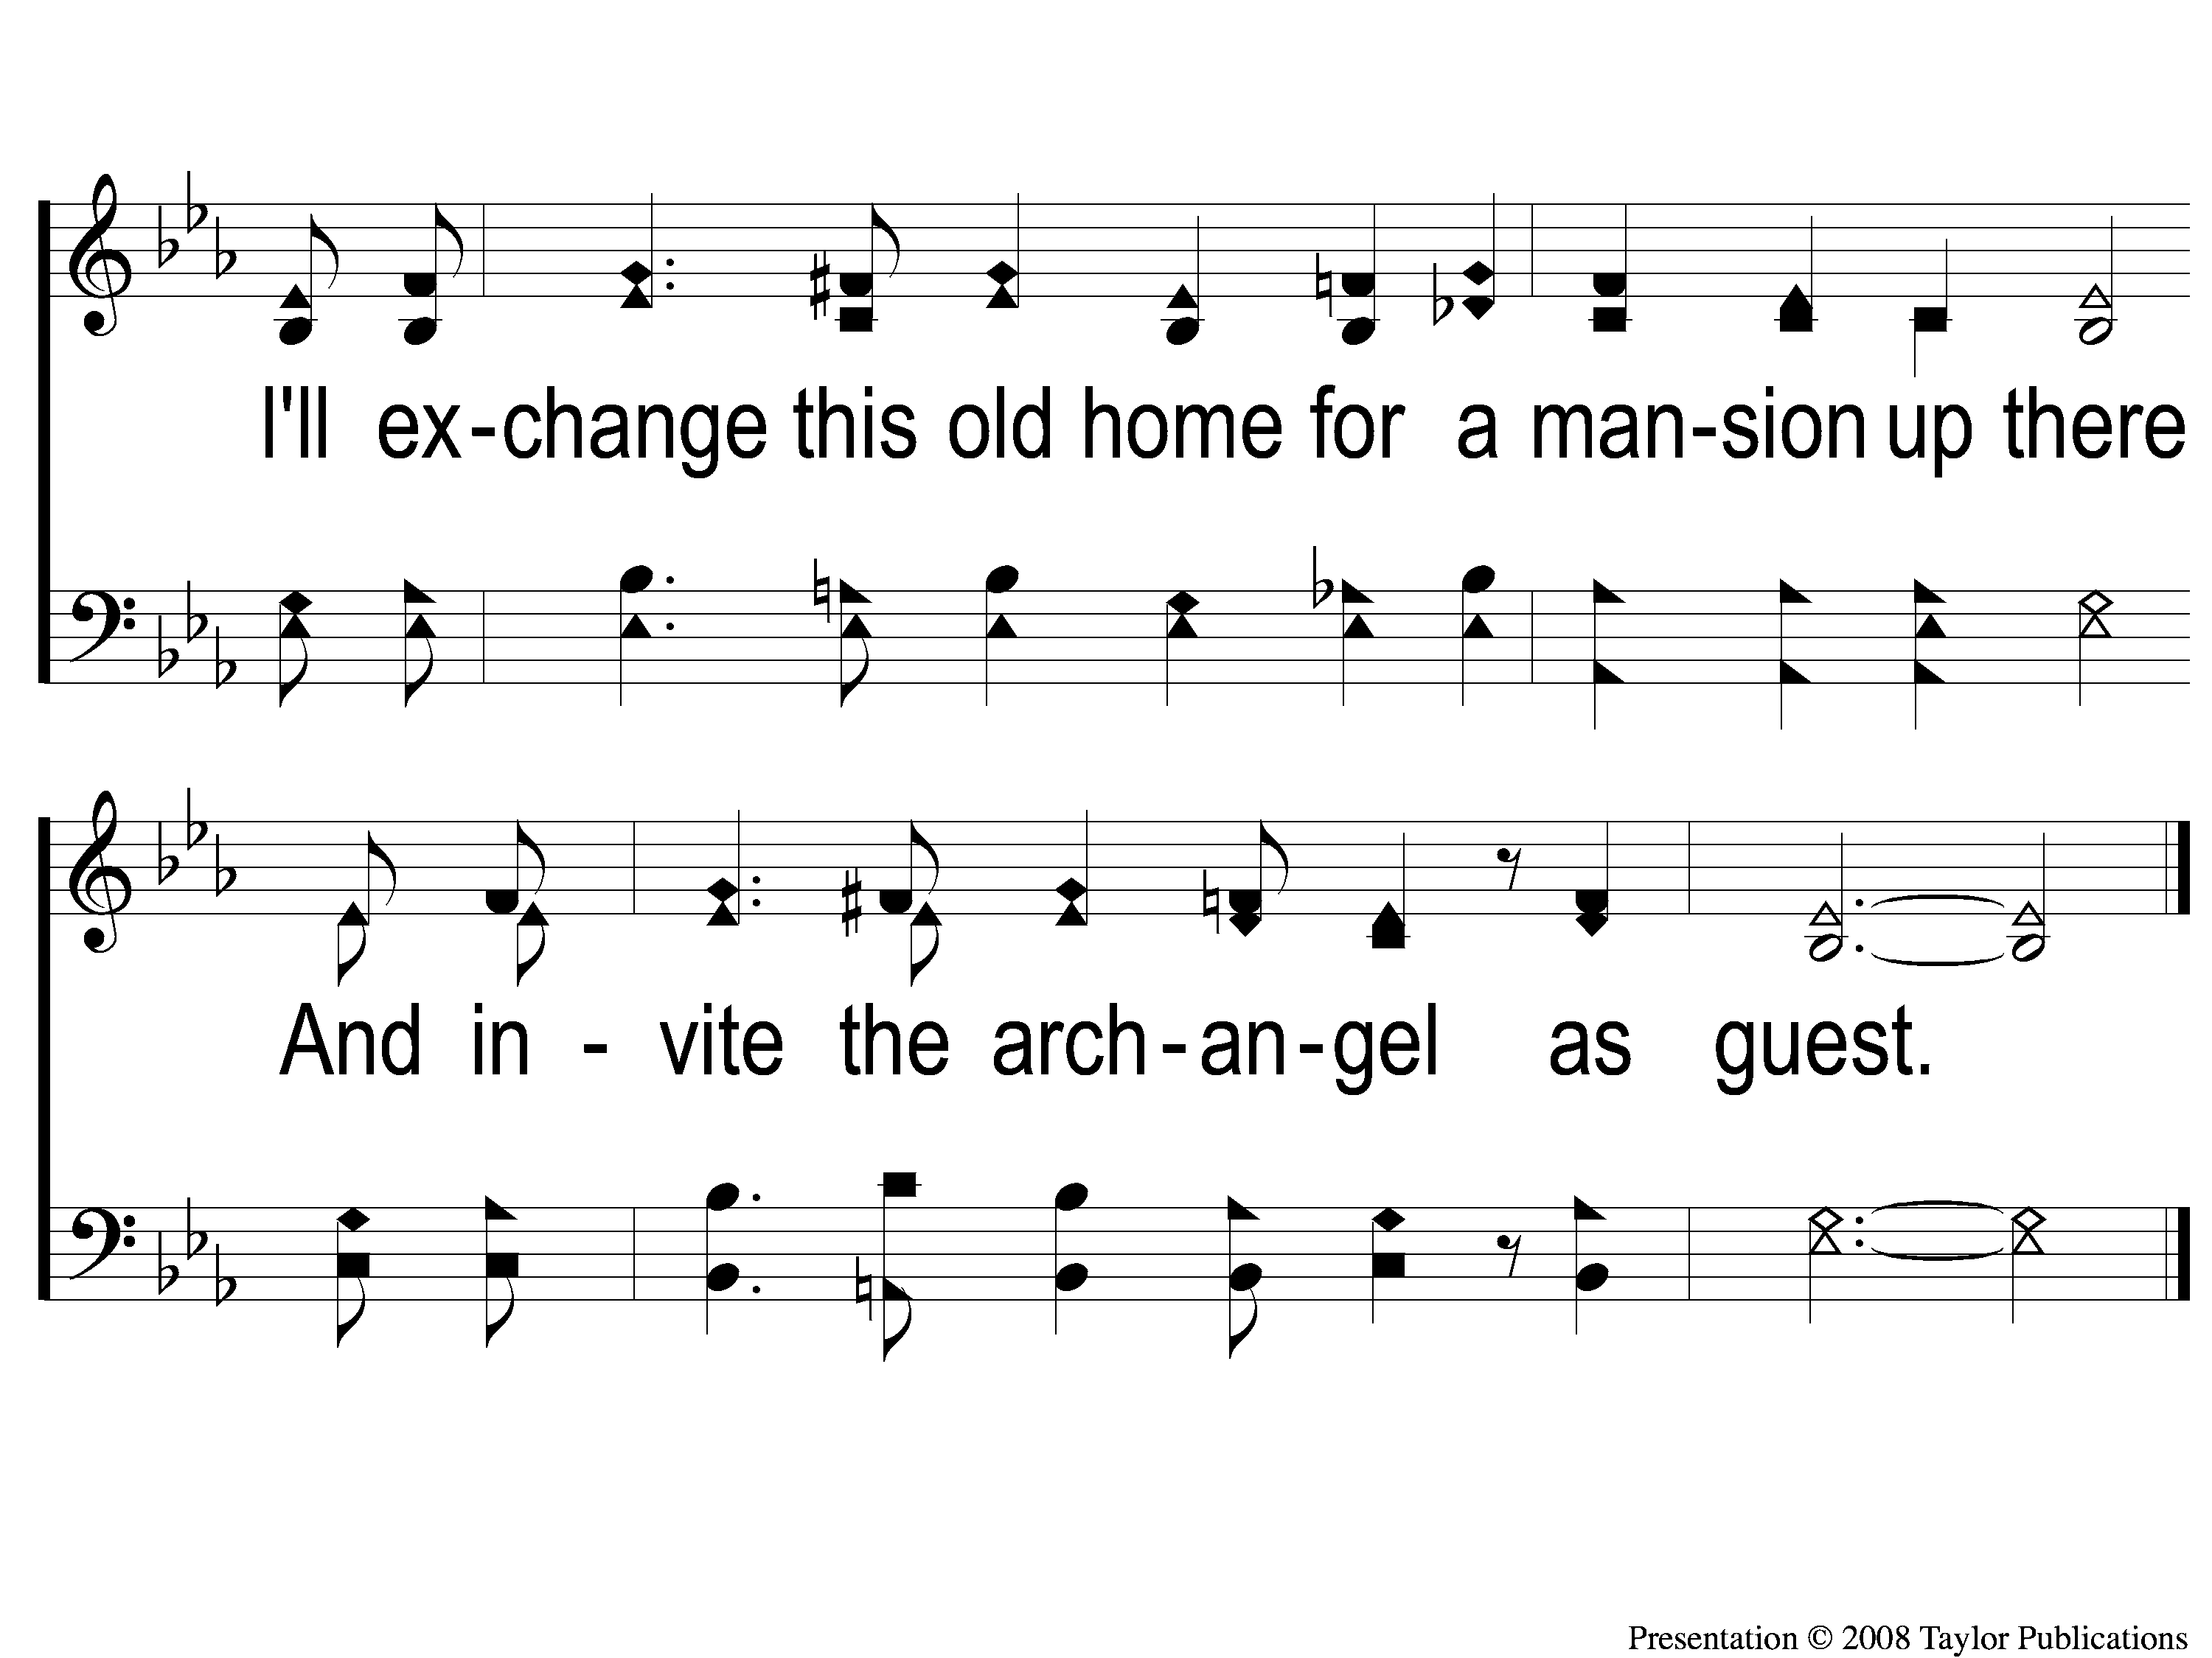
3-2 An Empty Mansion
An Empty Mansion
5

Slide 11
C-1 An Empty Mansion
An Empty Mansion
5

Slide 12
C-2 An Empty Mansion
An Empty Mansion
5

